Slide 1


Software Engineering Department Braude College
23-2-D-19
Supervisors:
Alexander Keselman
Present:
Shaked Arish: 311420384
Sean Friedman: 204404511

Slide 2
Overview
1
2
3
Introduction
Video Content Today
Our Project
4
5
6
Process
Challenges
Conclusion

Slide 3
Introduction
In our modern world, social platforms play a significant part in our lives and became a powerful way for individuals and companies as one to:
Express ideas
Share information
Build brand
Connect with their target audience
Notes:
It became a powerful tools for anyone who want to and give the ability to:

Slide 4
Introduction
Short videos especially have become incredibly popular, on platforms like TikTok and YouTube due to their ability to capture the attention of the user.
These videos provide a convenient way for users to engage with content quickly and efficiently.
Notes:
Short videos especially have the ability to capture the attention of the user.
These videos provide a convenient way for create a content quickly and efficiently

Slide 5

Video Content Today

Slide 6

Video Content Today
How Video Content Made Today:
Manual Video Production
Template-based Automated Systems
Notes:
Manual Video Production
it offer full creative control but require a lot of time, resources, tools, and background knowledge
On the other hand,
Template-based Automated Systems
provide a simplified process but their result is often generic and repetitive videos that dont to meet user intent (not what he wish for)

Slide 7

Our project

Slide 8

Our Project
Our project recognizes the significance of social media and aims to change the process of generating smart content, by developing a platform that leverages the power of AI to help individuals and businesses from all backgrounds with no previous knowledge to produce high-quality video content with ease.

Slide 9

Process Description

Slide 10

Website Page
Our website is the starting point for accessing our application.
We aim to develop a website that is intuitive, friendly, and easy to use.
Notes:
We will keep a simple and modern design, consistent throw all the stages.
We will make examples on the site for the process

Slide 11

User Input
The next step is to gather the necessary information from the user to accurately understand his intention.
Topic
Duration time
Voice option
Key wards
Notes:
By answering this few simple questions in the form,
The users provide us with the necessary information to generate their video.

Slide 12

Integrate User Input
By integrating the user input with a precise, pre-built template we can use the power of AI in a more accurate and efficient way.
Notes:
AI tools like ChatGPT broke into our lives recently,
most people who are not in the field have not gotten to experience it
even those who do usually do not know how to utilize its powers in an optimal way.
The uniqueness of the form we will create is to know how to take advantage of these capabilities.

Slide 13

Script
With the capabilities of ChatGPT we generate a script for the video.
The user has the ability to confirm and edit the script.
Notes:
The produced script is about the subject of the user according to his preferences in terms of
creativity and the nature of the video

Slide 14

Voiceover
In the next step, the user can change and adjust the voiceover as he wishes.
This will be done with the help of TTS (Text-To-Voice) API

Slide 15

Video
By understanding the context of each scene in the script, we will make an accurate request for a relevant video API and generate suitable videos that align with the script.

Slide 16

Merge Components
Finally, the last step is merging the selected videos, along with the voiceover and subtitles to create a cohesive and captivating video that truly brings the user's vision to life.

Slide 17

Video Is Ready…
Notes:
The user can save the video, download it and share it on social networks

Slide 18
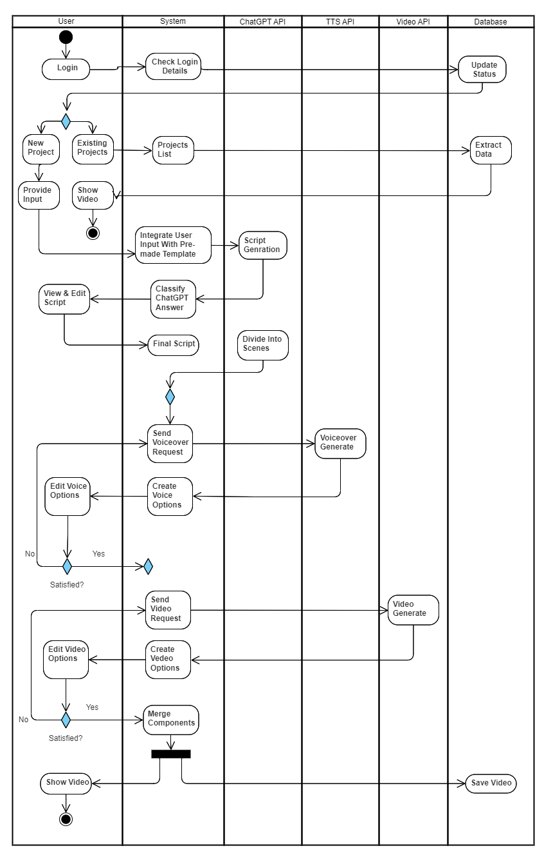
Activity Diagram

Slide 19
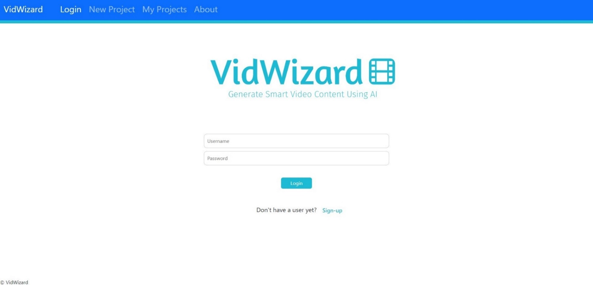
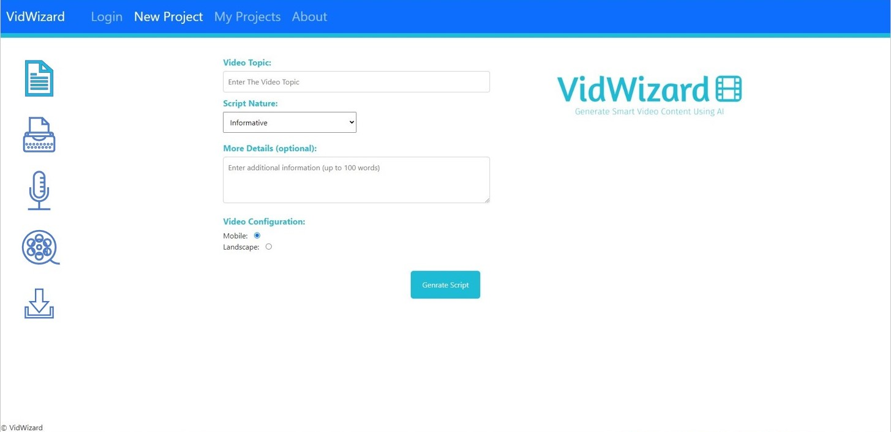
User Interface Prototype

Slide 20

Constraints and Challenges

Slide 21
Constraints and Challenges
Integration with the AI API’s
Generate accurate and high-quality content that meets the user's intent
Generate content within an a acceptable time
Filter inappropriate content
Handling large number of users simultaneously

Slide 22

Conclusion

Slide 23

Conclusion
In conclusion, our project is about making video content generation accessible to a wider audience, regardless of their video editing skills and technical expertise. empowering them to share their ideas and stories effectively through the help of AI powered technologies.

Slide 24

Thank You

